Slide 1



Digital India
Shubham Kashinath Chaudhari
Class:SYMCA
RollNo:27

Slide 2
CONTENTS:
Project Profile
Tool & Components
Scope of the Proposed
System Objective
Feasibility Study
Diagrams
System Design
Future Enhancement

Slide 3
Project Profile
Project Name: Digital India
Type of Application: IOT base Application
Project Description: Digital India is an Android and iOS application for India’s fastest growing IOT service providers to operate home appliances via smartphones. Digital India is building automation for a home for digitalize home applications. A Digital India system will monitor and/or control home attributes such as lighting, climate, entertainment systems, and appliances. It may also include home security such as access control and alarm systems. When connected with the Internet, home devices are an important constituent of the Internet of Things.
Front End: React
Back End: Express.js, Nodejs
Database: Mongo DB

Slide 4




Tool & Components
Tools and Technology : MERN Stack,
(MongoDB, Express,React, Node)
Front End : React
Back End : Express.js, Nodejs
Database: Mongo DB

Slide 5
Scope Of The Proposed System
The home automation market is primarily driven by growing need for effective solutions in various domestic applications such as lighting, safety and security, energy management, entertainment, and HVAC (heating, ventilation, and air conditioning).
Digital India systems involves making homes even smarter. Homes can be interfaced with sensors including motion sensors, light sensors and temperature sensors and provide automated toggling of devices based on conditions.

Slide 6
System Objective
To make whole process easy, effective and time saving
To provide easy and efficient service to customer
Very easily accessible and easy to maintain easy to access from anywhere

Slide 7
Feasibility Stydy
Operational Feasibility
Technical Feasibility
Economic Feasibility

Slide 8
Operational Feasibility
Operational feasibility is studied in order to check, whether the human or employees in the business will use it or not.
Operational feasibility relies on human resources and analyses whether the software will operate after it is developed properly or not.
The GUI is designed to be user friendly, so it is easy to use by admin. There is only one user which handles the website i.e., Admin. So, the manpower required is less here.
This software will have very easy to use, user friendly interface so it will be pretty much operable by anyone having little experience android or iOS phone.
It could be helpful for physically disabled person too, controlling home applications with the click of a button. So, it is operationally feasible.

Slide 9
Technical Feasibility
The admin only requires Internet connection to use this website. So, this website is technically feasible.
Our system is technically feasible it is providing us required output.
The system is based on wireless technology and embedded system which are reasonably in phase with currently used technology. Therefore, it is very much favored by the technology.

Slide 10
Economic Feasibility
Economic Feasibility helps in determining whether the required software has the potential to generate financial gains for an organization.
This type of study involves the cost incurred on the team of the software development, cost of study involved in conducting a feasibility study, estimated cost of software and hardware.
The only person working here is admin. So due to reduced manpower, the cost of wages is also reduced. Hence making it cheaper.
Here the cost of hardware is affordable

Slide 11
Diagrams
Use Case Diagram
Data Flow Diagram
Class Diagram

Slide 12
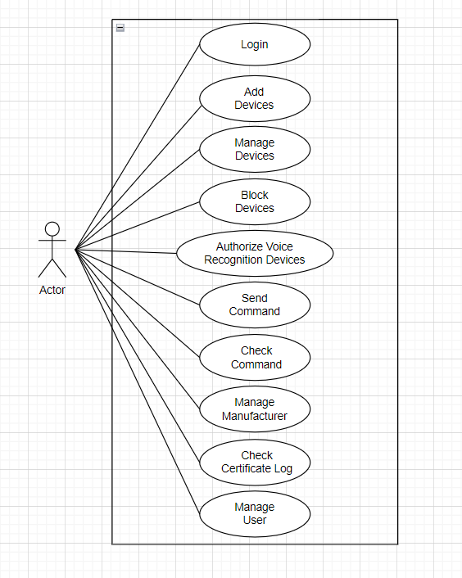
Use Case Diagram

Slide 13
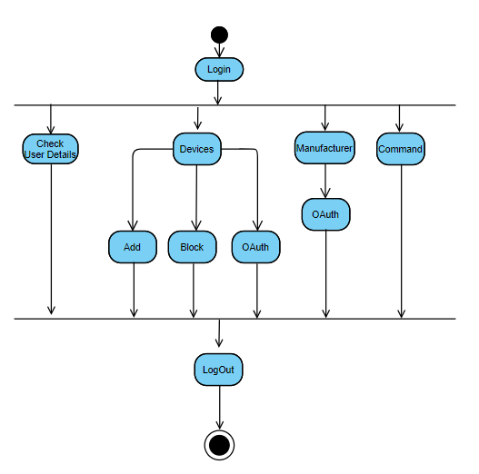
Data Flow Diagram

Slide 14
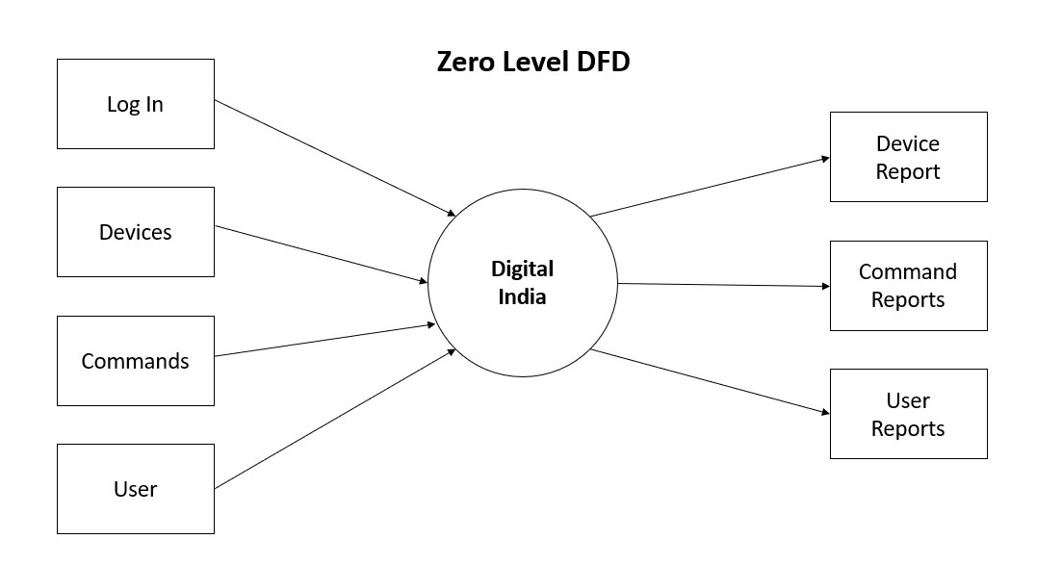
DFD Zero Level

Slide 15
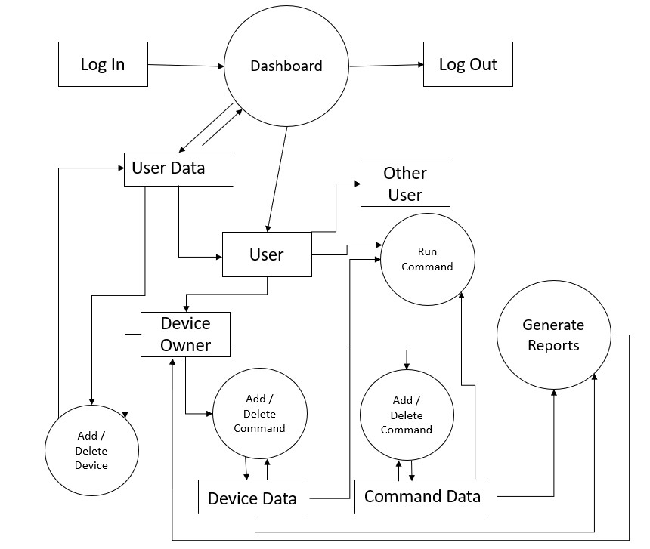
DFD One Level

Slide 16
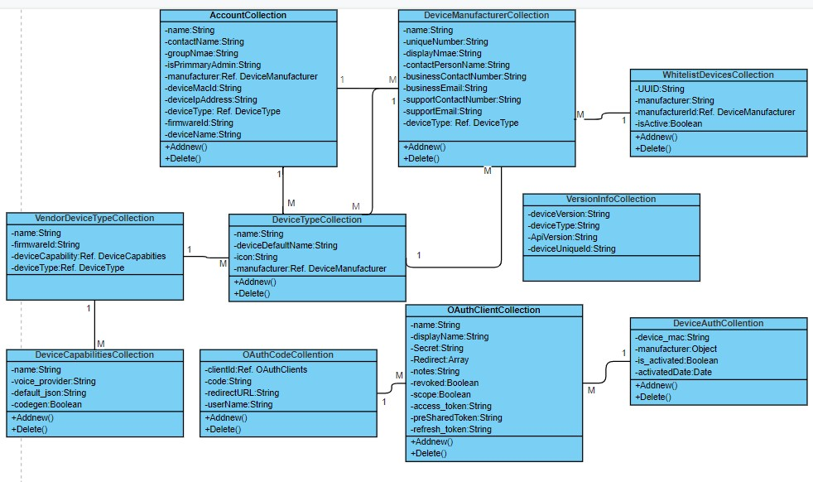
Class Diagram

Slide 17

System Design
Data Dictionary

Slide 18
AccountCollection
Entity | Data Type | Size
name | String | 50
contactName | String | 50
groupName | String | 50
isPrimaryAdmin | Boolean | -
manufacturer | Object | -
deviceMacId | String | 30
deviceIpAddress | String | 30
deviceType | Object | -
firmwareId | String | 20
deviceName | String | 20

Slide 19
CommandCollection
Entity | Data Type | Size
command | JSON | 20
DeviceAuthCollention
Entity | Data Type | Size
device_mac | String | 30
Manufacture | Object | -
is_activated | Boolean | -
activated_date | Date | -

Slide 20
DeviceManufacturerCollection
Entity | Data Type | Data Type
Name | String | 50
uniqueNumber | String | 20
displayName | String | 50
contactPersonName | String | 50
businessContactNumber | String | 20
businessEmail | String | 50
supportContactNumber | String | 20
supportEmail | String | 50
deviceTypes | Object | -

Slide 21
DeviceCapabilitiesCollection
Entity | DataType | Size
Name | String | 50
voice_provider | String | 50
default_json | String | 30
Codegen | Boolean | -
DeviceTypeCollection
Entity | Data Type | Size
Name | String | 50
DeviceDefaultName | String | 50
Icon | String | 50
Manufacture | Object | -

Slide 22
OAuthClientCollection
Entity | Data Types | Size
Name | String | 50
Display_name | String | 50
Secret | String | 50
Redirect | Array | 100
Notes | String | 100
Revoked | Boolean | -
Scope | Boolean | -
Access_token | String | 200
PreSharedToken | String | 200
Refresh_token | String | 200

Slide 23
OtpCollection
Entity | Data Type | Size
MobileNo | String | 20
Otp | String | 10
otpValidThrough | Date | -
VersionInfoCollection
Entity | Data Type | Size
DeviceVersion | String | 50
DeviceType | Object | -
ApiVersion | String | 50
DeviceUniqueId | String | 50

Slide 24
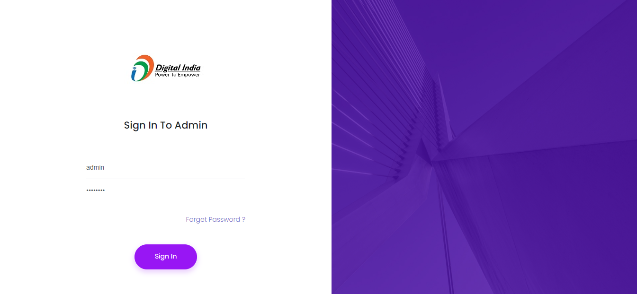
Screen Layouts

Slide 25
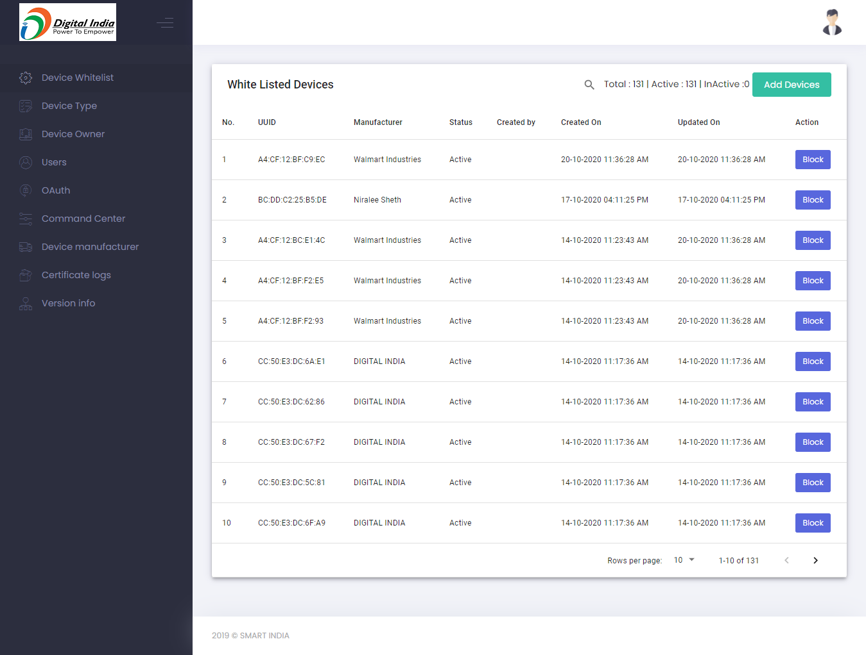

Slide 26
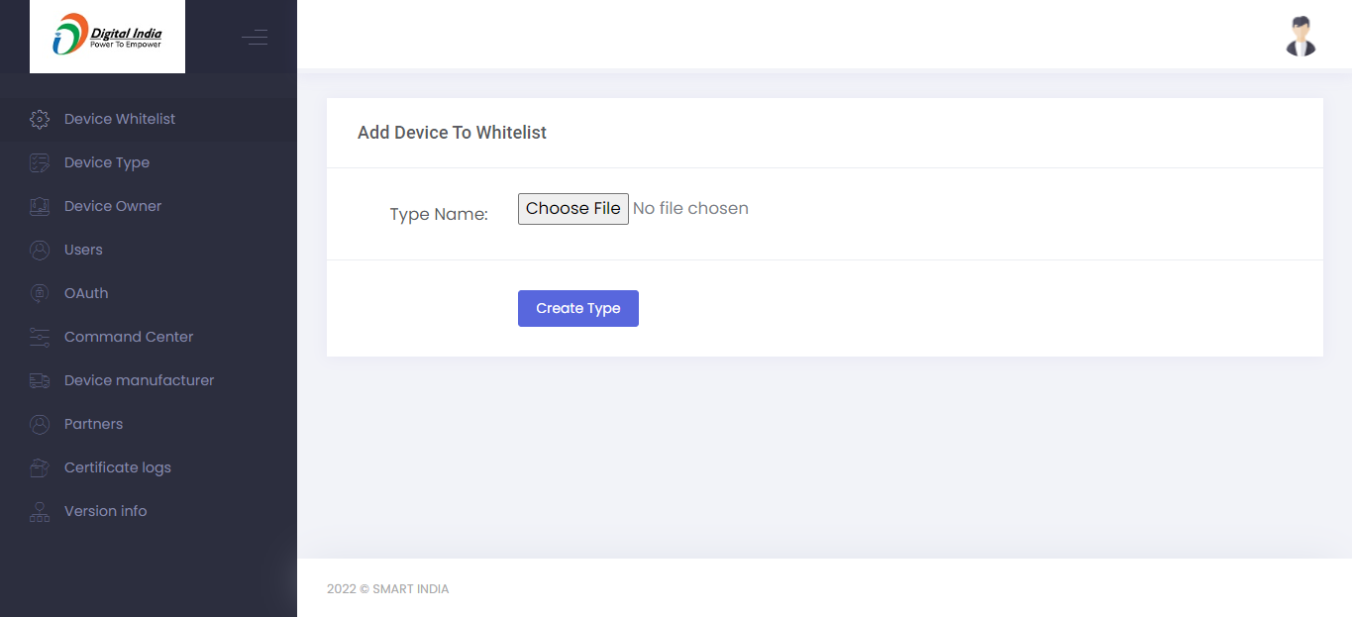

Slide 27
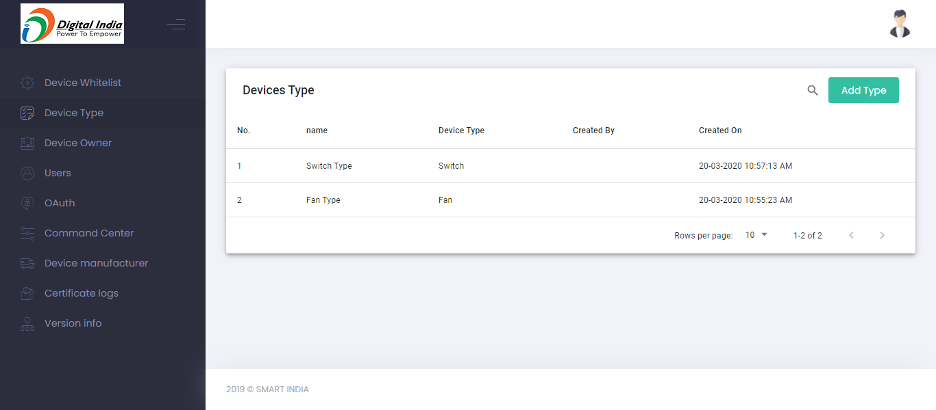

Slide 28
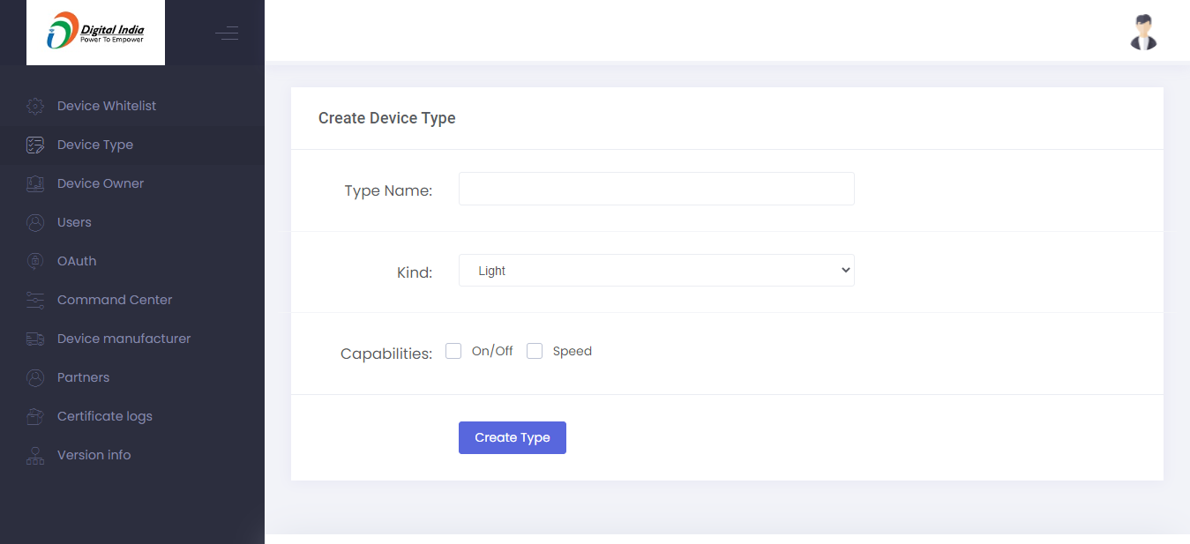

Slide 29
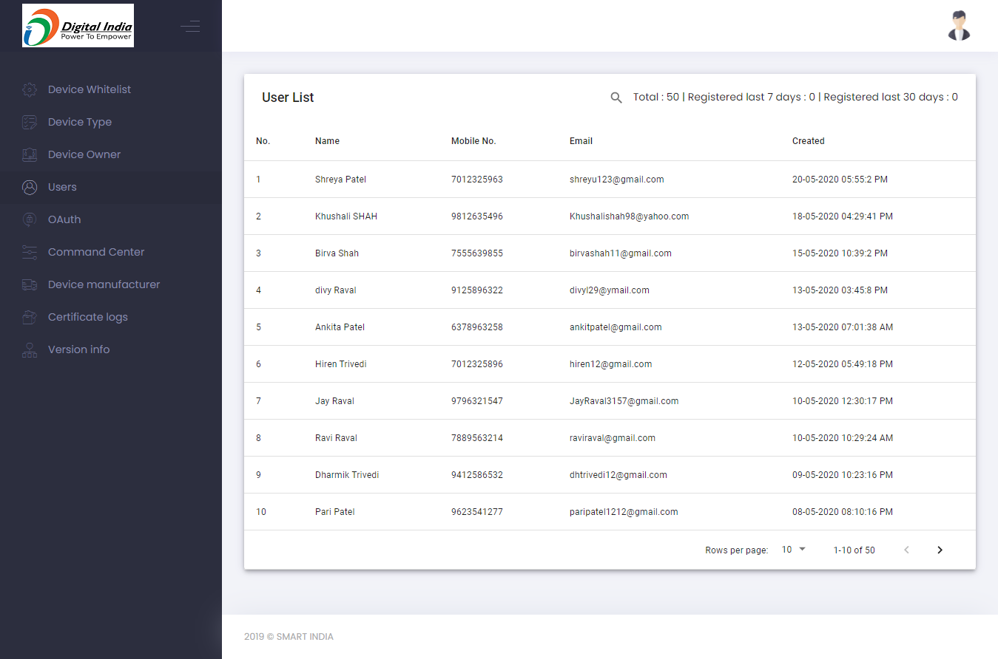

Slide 30
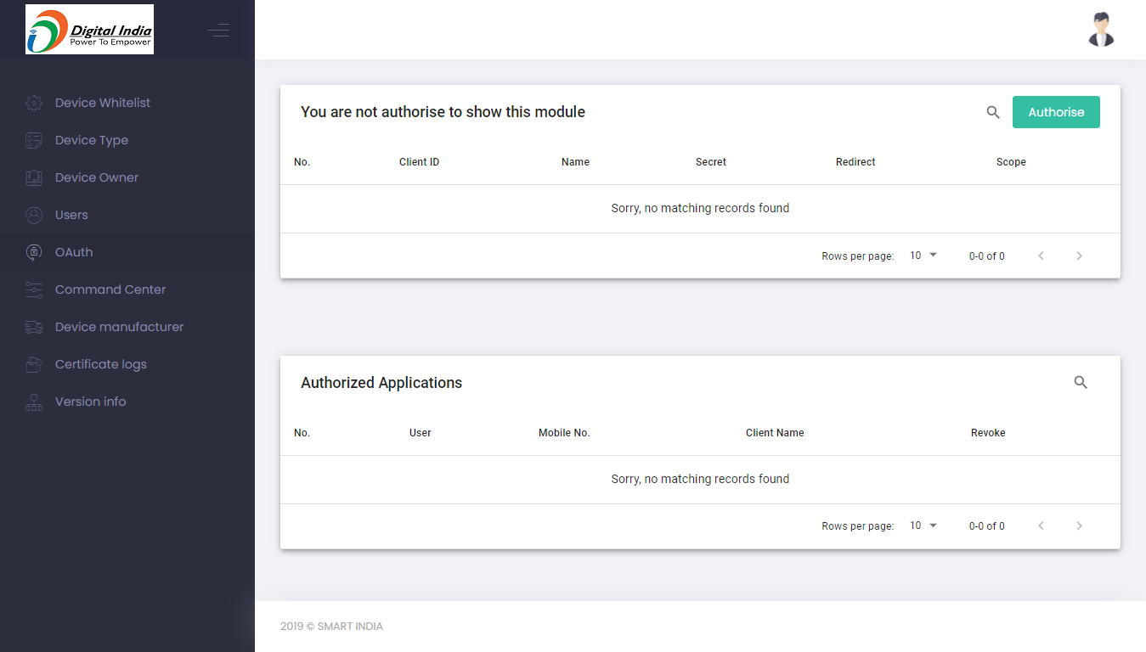

Slide 31
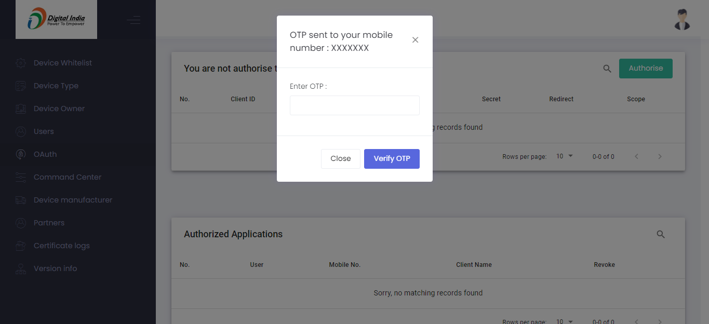

Slide 32
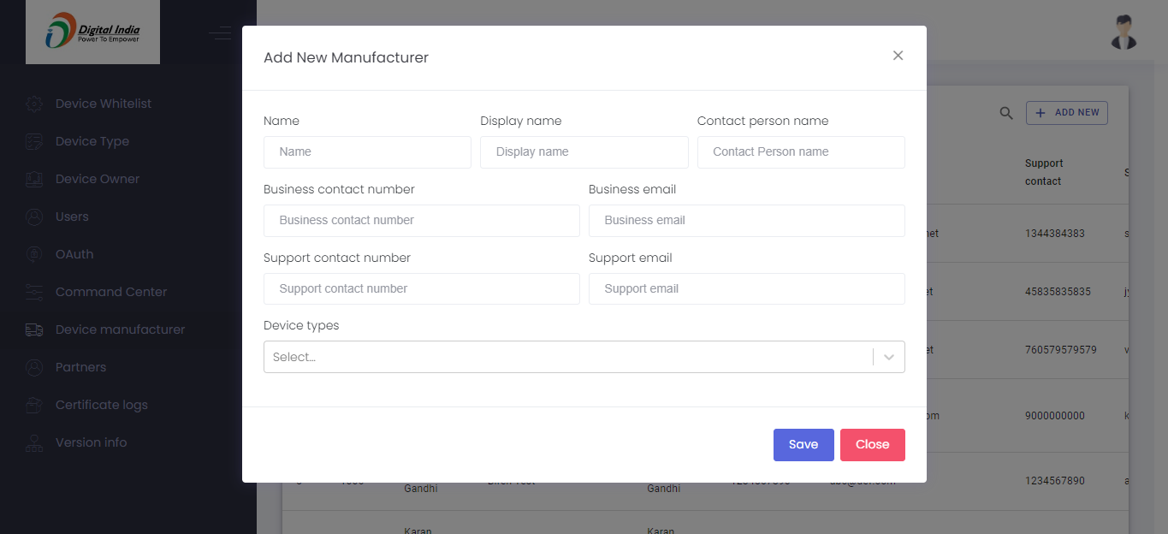

Slide 33
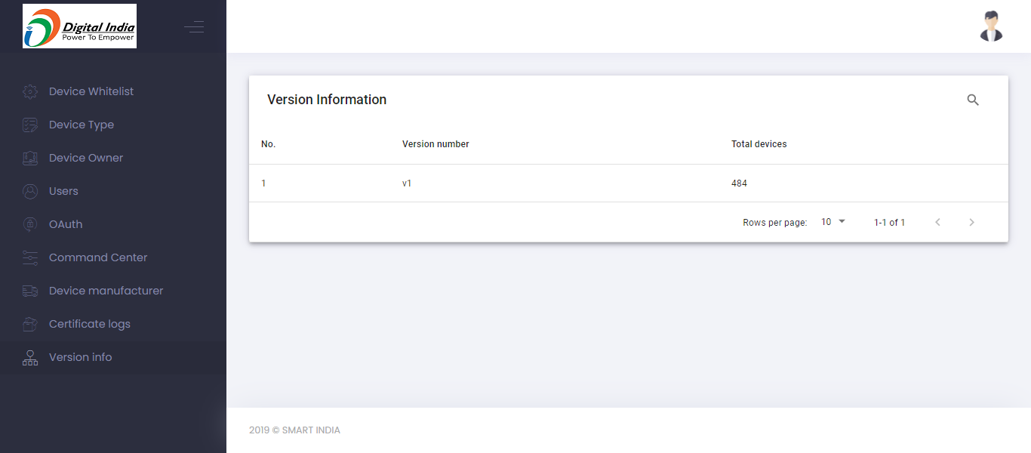

Slide 34
Thank you

